Slide 1

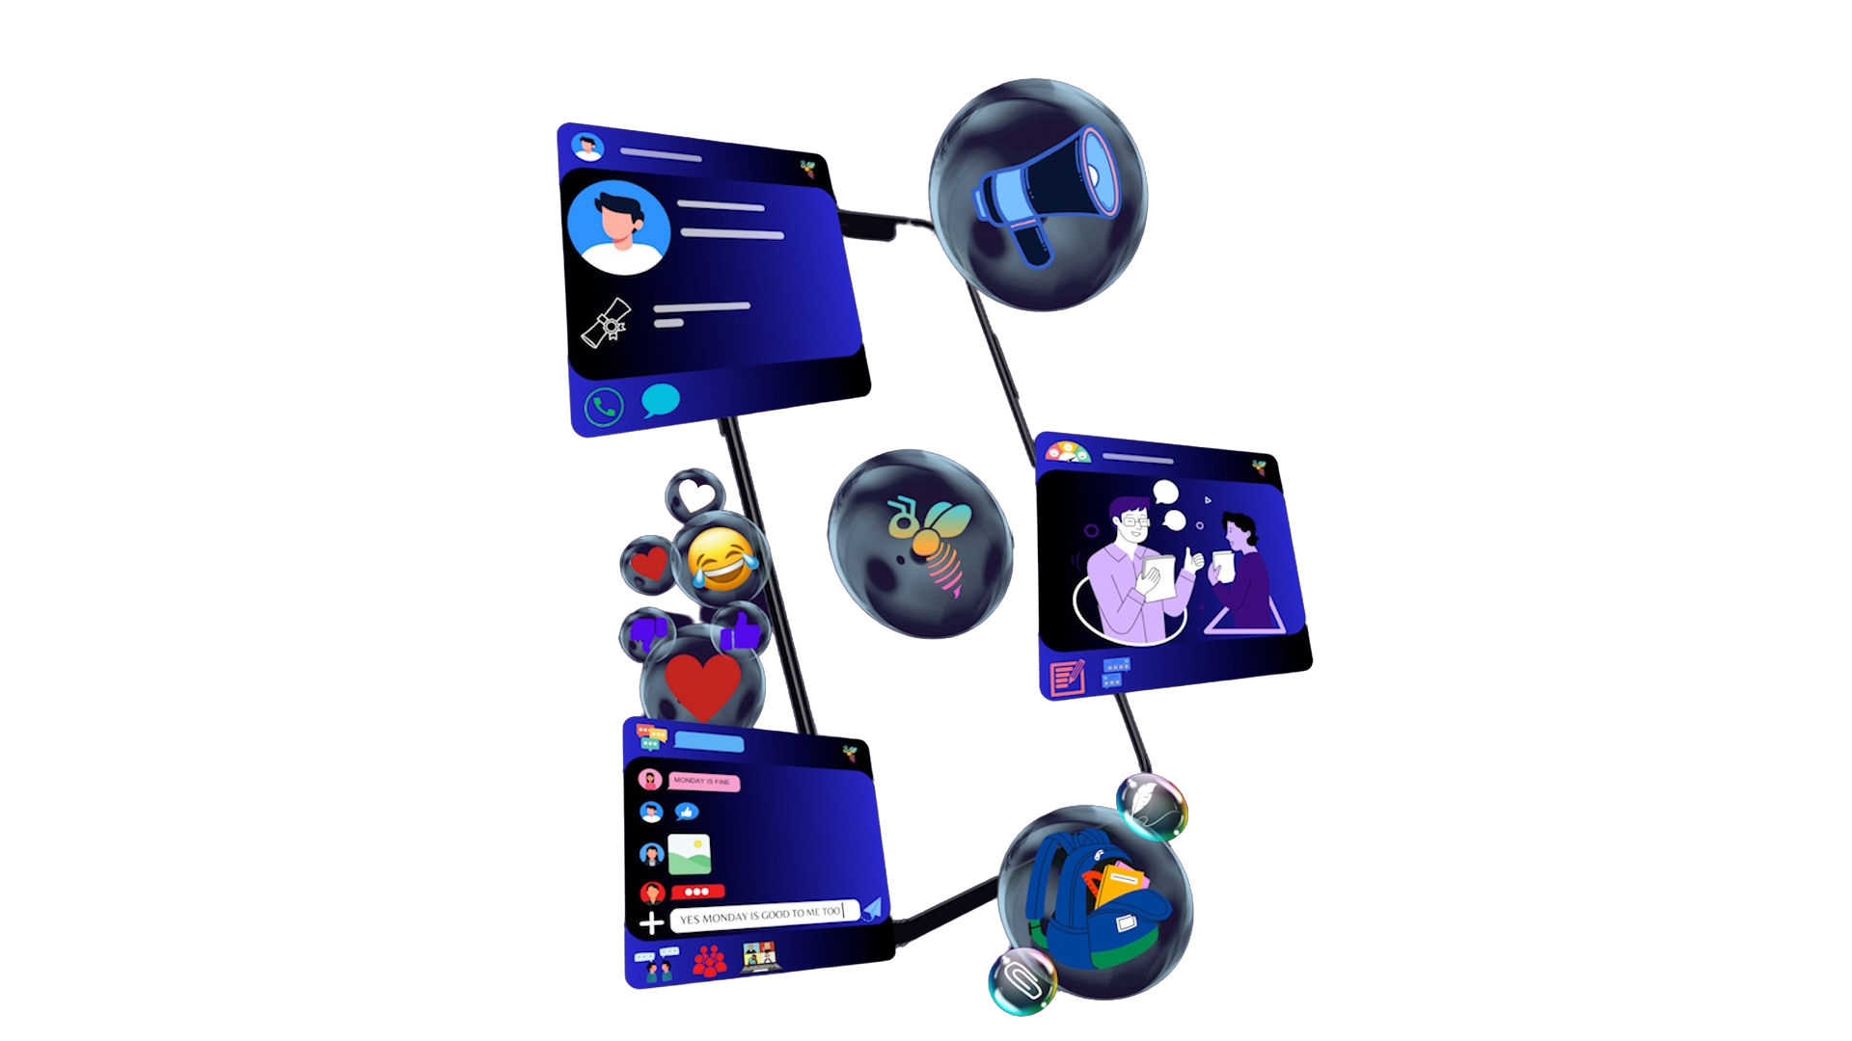
CAMPBUZZ
By Buzznet Project Inc.​
You Just Received a Buzz!
“Join a supportive academic community and enjoy campus life. Access discussion rooms, tools and transparent feedback to learn and interact effectively.”
https://www.canva.com/design/DAF2sgDmjnU/Ygr9p8yxBZ41RHZ_6sms8g/edit?utm_content=DAF2sgDmjnU&utm_campaign=designshare&utm_medium=link2&utm_source=sharebutton
CANVA LINK FOR ANIMATIONS

Slide 2

Buzznet Project Inc.
Buzznet is where we bring clients vision to life .
Our main goal is to produce software that will last and provide consumers with a fresh experience.
​
We work by breaking the projects into dynamic phases and focussing on continuous collaboration and improvements
​
We welcome change and perform in iterations.​
Our aim is to deliver value to our customers quickly ​
​

Slide 3


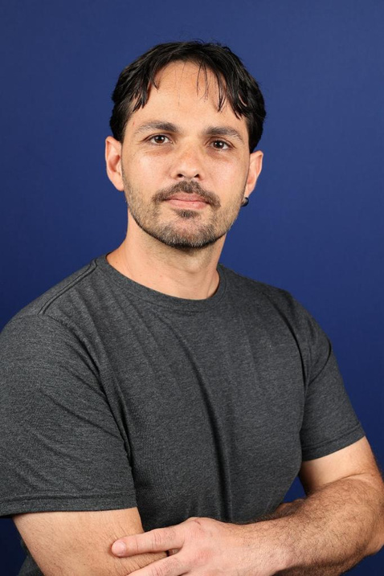

Meet our team
Payal Rangra
Product Owner
College Lasalle
Aryan Handa
Scrum Master
College Lasalle
Diego Lins Ferreira
Developer
College Lasalle
Reena Simpson
Developer
College Lasalle

Slide 4


Motivation :
1
Ineffiective feedback system
2
Limited/Restricted Academic expression
3
User dissatifaction with interface
4
Inadequate platform for students communication

Slide 5











Main Features and unique selling points:
Colaborative tools
Announcements
& Real-time notification
Profiles
ChatBot
Post
Anonymous
Feedback
Chats
AND
Voice Space
Assingment
And
Courses
Content moderation

Slide 6


How Campbuzz can help ?
Sustainable Academic Performance Boost
Elevated Institutional Success
Heightened Employee Satisfaction
Dynamic Adaptability and Growth

Slide 7


Budget
Database Storage and Server Hosting
Designing And Development
Total: $415,000
Total: $170,000
Research & Planning
Total : $56,000
Marketing
Total:$ 70,000
Operational and location cost
Total: $256,000

Slide 8

Revenue Generation Strategy
Planning to collaborate with educational networks like L.C.I , this will give us an upper edge in the market and allow us to integrate our application with more than 25 well know Canadian Universities and colleges.
Customized platform for Colleges:
In-app advertisements:
Job listings:
Monthly subscription:27$ per month.
Aiming 150 Companies
We plan to generate an additional $300,000
With 50,000 users in year 1 profit is expected to be $250,000
Charges : 6000$ per college
Expected to generate $150,000
from 25 institues

Slide 9

Return on Investment (R.O.I)
Total Investment for Start-Up
1.2M
Expected profit in 1st year is $500K
R.O.I
41.6%
15%
Yearly Increment

Slide 10
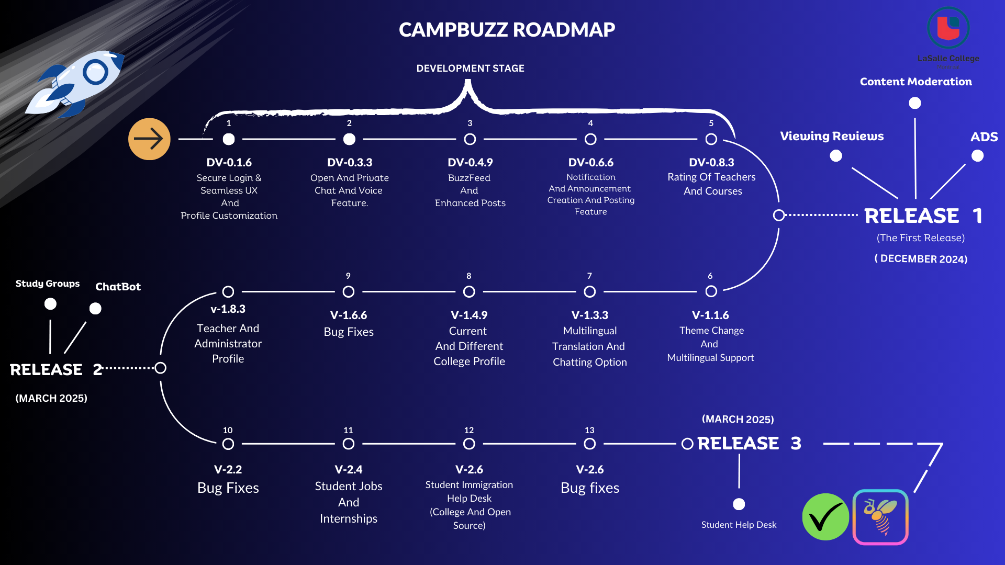

Slide 11
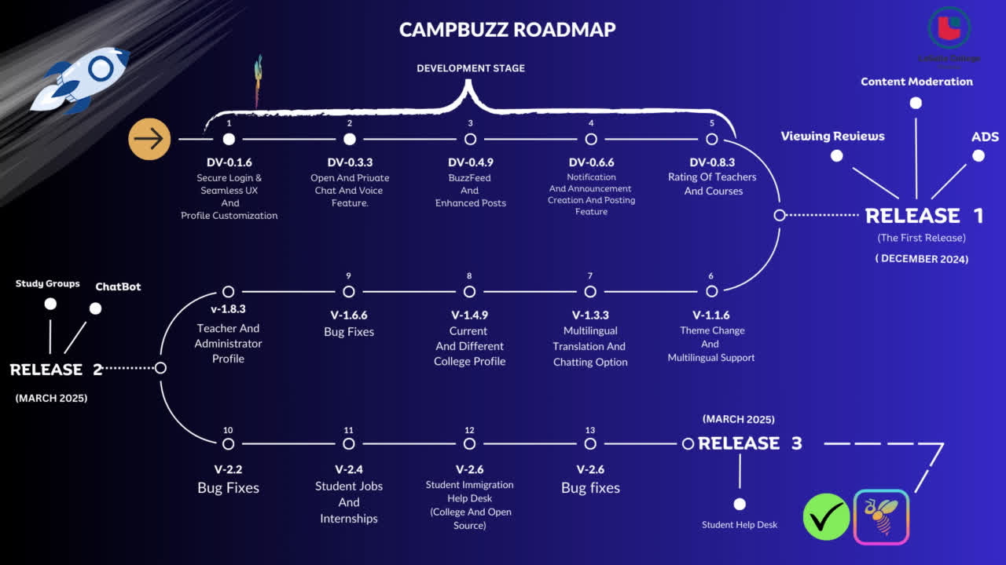

Slide 12
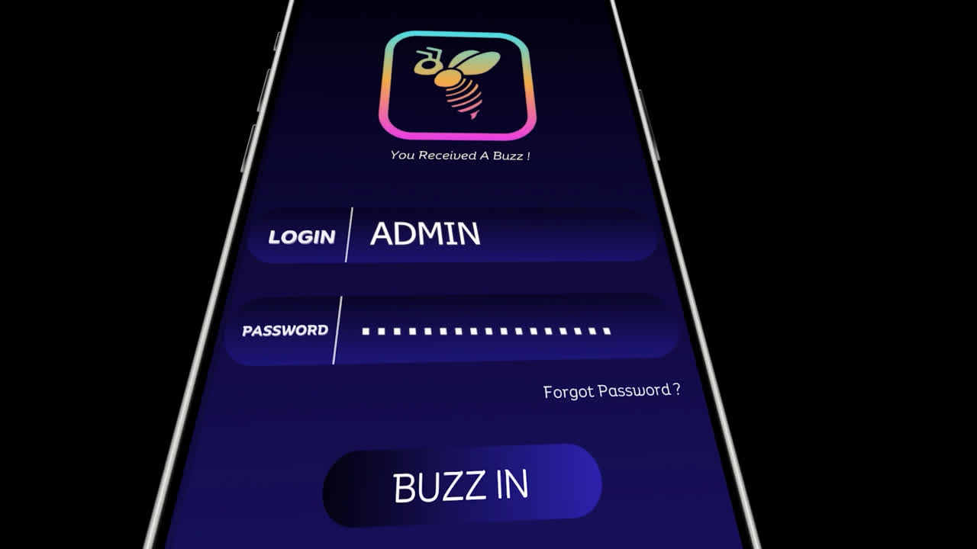

Slide 13



Thankyou
+1-2425552452
Contactus@campbuzz.com

